Slide 1
Funding Process Meeting
November 13, 2024
Notes:
To ensure that the UNITED WE FIGHT. UNITED WE WIN. Artwork is on top of the photo you may have to click on photo box and select to SEND TO BACK.

Slide 2
Agenda
Welcome and Introductions
FY 2025-2026 Priority Needs
Priority Considerations
Overview of Funding Process
Online Application Portal
Common Application Errors
Performance Measures (Outcomes) Section
Questions and Answers

Slide 3
Welcome and Introductions
Notes:
Introduce Sarah (and Michael?); acknowledge members of RIC who are present

Slide 4
Mission and Vision
Mission: Pocono Mountains United Way engages and mobilizes resources to improve lives through accelerated community change.
Vision: A community where everyone has ample opportunities for quality education, good health, and financial stability.

Slide 5
FY 2025-2026 Priority Needs
Education
Financial Mobility
Health
Notes:
Priority needs are not ranked this year – all have equal weight

Slide 6
FY 2025-2026 Priority Needs
Mental Health
Innovative solutions including self-help, social support and prevention of mental health disorders
Basic Needs
Food
Transportation
Childcare

Slide 7
FY 2025-2026 Priority Needs
Domestic Violence
Housing
Rental assistance, housing/eviction counseling, financial counseling/coaching
Other innovative approaches to stabilizing renters
Assistance for people experiencing homelessness
Addressing at-risk homeowners
Notes:
Priority needs are not ranked this year – all have equal weight

Slide 8
FY 2025-2026 Priority Considerations
Address ALICE population
Strategies to reduce benefits cliffs
Expansion of programs to serve up to the ALICE Survival Threshold or ALICE Stability Threshold
Address disproportionate impacts on People of Color and Socially Disadvantaged households
Address disproportionate impacts on women

Slide 9
Overview of Funding Process
​ | ​
January 1, 2025 | Application for FY 2025-2026 funding opens
January 31, 2025 | Applications due
February 2025 | Financial Review Panel meetings
March-April 2025 | Program Review Panel Meetings and Site Visits
Late May​ 2025 | PMUW Board of Directors approves panel funding recommendations​
Early June​ 2024 | Funding announcements made​
August 2025 | First quarterly payments made
August 15, 2025 | FY 2024-2025 End of Year Reports due
January 2026 | FY 2025-2026 Mid-Year Reports due
August 17, 2026 | FY 2025-2026 End of Year Reports due

Slide 10
Overview of Funding Process
For FY 2025-2026, any nonprofit serving Monroe County may apply for funding
Eligibility criteria apply, see Request for Applications (RFA) for full details
RFA will be released December 1, 2024
See https://poconounitedway.org/resource-investment-process/

Slide 11
Overview of Funding Process
Volunteers from our community work on panels to conduct reviews
Financial Reviews
Program Reviews
The Resource Investment Committee makes funding recommendations to the Board of Directors
Board of Directors approves total available dollars and final funding amounts for each program

Slide 12
Overview of Funding Process
“Hybrid Site Visit” Model
Approximately 1/3 of funded agencies will have an in-person meeting each year
Remaining agencies will be reviewed by panels alone; questions will be directed to agencies with time for response before final recommendations are made
If site visits are not possible or your agency has particular restrictions in place, please note that in the application

Slide 13
Online Grant Portal
e-CImpact
Access at
agency.e-cimpact.com/login.aspx?org=40570U

Slide 14
Online Grant Portal
Agency Training Manual Available Here

Slide 15
Online Grant Portal
Returning users sign in here
User Name
New users create an account here

Slide 16
Online Grant Portal
Agency Information
Only required once per agency
Agency Status
Agency Budget
Agency Fiscal Abstract
PATRIOT Act Information
Program Information
Required for each program requesting funding
Program Overview
Program Budget
Program Budget Narrative
Performance Measures (Outcomes and Outputs)
Optional: Program Success Story

Slide 17
Online Grant Portal
Required Attachments
IRS Tax-Exempt Determination Letter
Most Recent Annual Report
IRS Form 990 or 990 E
Financial Audit or Review
Current Certificate of Registration from Department of State, Bureau of Charitable Organizations
Board of Directors Roster
Agency Organizational Chart
Agency Non-Discrimination and Conflict of Interest Policies

Slide 18
Common Errors: Agency Application
Please be sure to provide the correct budget type:
Agency Budget (also called Operating Budget)*
Refers to the budget for the entire organization
Program Budget
Refers to the budget only for the specific program/portion of agency activities seeking funding
Grant Budget – this is not requested by PMUW
Refers to the budget showing only how grant funds will be expended
*we are aware that a few agencies consider the entire organization one program, they will provide the same numbers for Agency and Program Budgets

Slide 19
Common Errors: Agency Application
Agency Budget
For prior year budget, use the last completed budget year, regardless of dates (e.g., fiscal year, calendar year, etc.)
Line F should include funding received from Pocono Mountains United Way (prior year budget/actual) and funding requested (current budget)
We recognize that if the full requested amount is not received, it will change the current budget figures
However, if no funds are shown, it will appear that funding from PMUW is creating a surplus
Check the last line for accurate Surplus/Deficit
Volunteers do look at that information and will question large amounts in either direction
Notes:
The requested amount and amount of UW contribution shown in the program budget must be the same Include the full amount that you are asking for in your program budget. Many agencies are just putting in what they think they will get or just putting in “0” since they don’t know what they’re getting.
If budgets and requests do not match up, volunteers feel that you don’t expect to get your full ask and it makes them question whether you are just asking for money that you might not need or don’t feel your program deserves the full amount.
This also causes an issue because we have to contact the agency at the end of the process to request that they fix their budget so that the requested amount and budgeted amount line up.

Slide 20
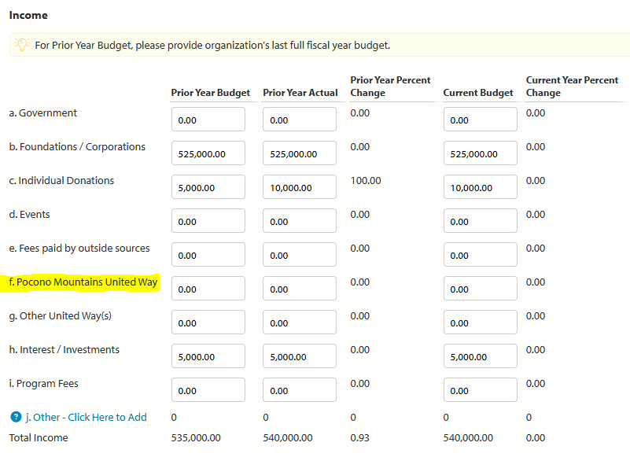
Common Errors: Agency Application
Notes:
The requested amount and amount of UW contribution shown in the program budget must be the same Include the full amount that you are asking for in your program budget. Many agencies are just putting in what they think they will get or just putting in “0” since they don’t know what they’re getting.
If budgets and requests do not match up, volunteers feel that you don’t expect to get your full ask and it makes them question whether you are just asking for money that you might not need or don’t feel your program deserves the full amount.
This also causes an issue because we have to contact the agency at the end of the process to request that they fix their budget so that the requested amount and budgeted amount line up.

Slide 21
Common Errors: Agency Application
Agency Fiscal Abstract – Key Financial Information
Accurately calculate overhead rate from IRS Form 990
Typically, volunteers are looking for overhead costs to be no more than 25%
17.6%

Slide 22
Common Errors: Agency Supporting Documents
Ensure all documents are within current timeframes
Annual Report: FY23-24, CY 2023 or CY2024
IRS 990 or 990 EZ: 2023 or 2024
Financial Audit, Review or Compilation: FY 22-23, FY 23-24, CY 2022 or CY 2023
View full list of Agency Supporting Documents
Please contact PMUW staff if newer versions are expected after application due date

Slide 23
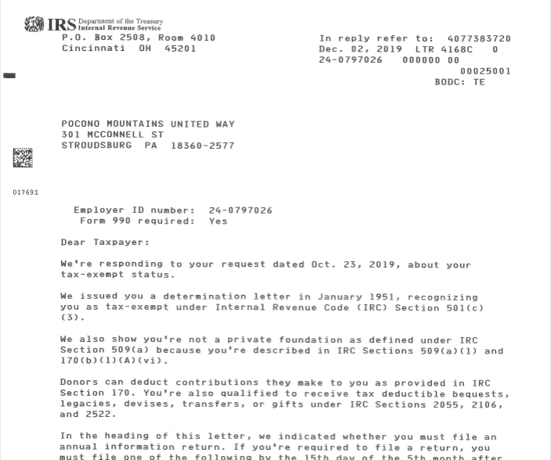
Common Errors: Agency Supporting Documents
Example Document – IRS Tax Exempt Status Determination Letter

Slide 24
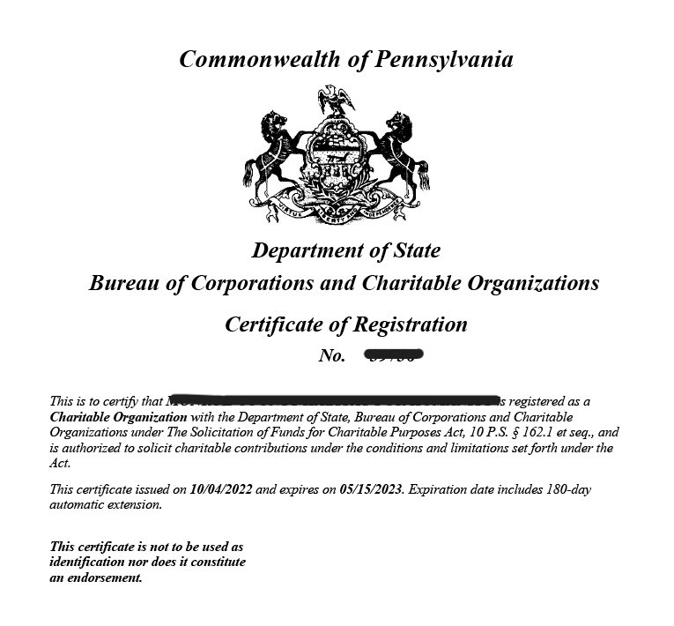
Common Errors: Agency Supporting Documents
Example Document – Certificate of Registration – PA Dept. of State, Bureau of Charitable Organizations (BCO)
Ensure the dates on your certificate are still valid!

Slide 25
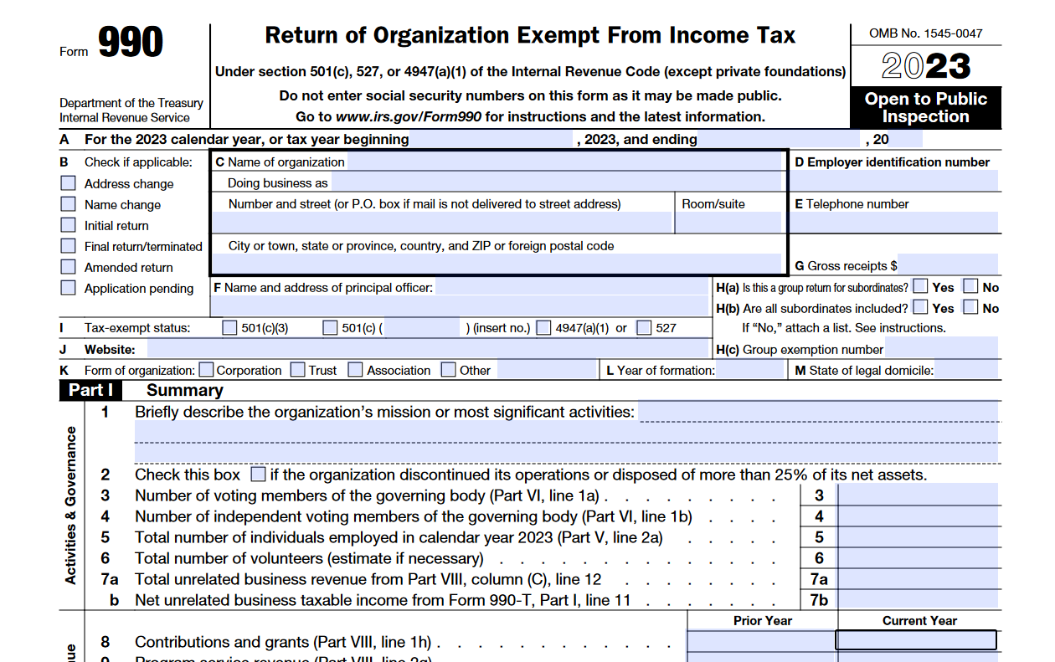
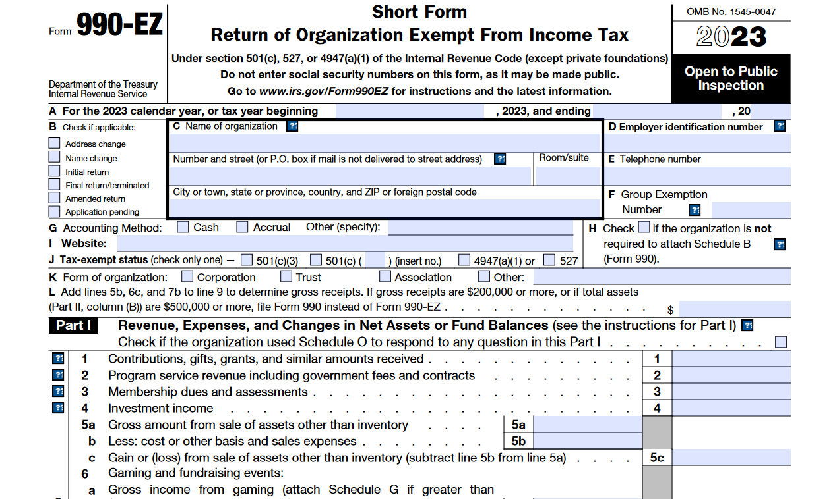
Common Errors: Agency Supporting Documents
Example Document – IRS 990 or 990 EZ Form

Slide 26
Common Errors: Program Application
Program Overview
Keep descriptions short and relevant to the program you are requesting funds for
Budget Information
Accurately calculate amount of funds requested as a percentage of program budget (not agency budget)
Divide PMUW request by total program expenses

Slide 27
Common Errors: Program Application
Program Budget
List full amount being requested from PMUW on Line D under Income
Verify surplus/deficit is accurate at the bottom of the budget
If a large surplus or deficit is shown, please provide context in the Program Budget Narrative section

Slide 28
Tips to Improve Applications
Use bullet points to list the important services that your program provides.
Shorter and more concise applications are easier for volunteers to understand why your program is beneficial. Focus on the program you are applying for and not everything that your agency provides.
Provide a video about your program. This video can be a news story, commercial, client testimonial, a video created in house or professionally, or anything that provides more information about your program. This is not required but encouraged.

Slide 29
Performance Measures (Outcomes) Section
Agencies are able to "write in" their own outcomes or use standard outcomes (click here for list)
If using standard outcomes, please consider if they accurately represent the change in participant status that your program seeks to accomplish
The outcomes you report on should ultimately answer the question...
"Are participants better off after receiving the service
than they were before?"

Slide 30
Performance Measures (Outcomes) Section
1-2 solid outcomes are fine
We understand that it can be a process to determine and track outcomes
Our goal is to better capture the impact that PMUW dollars make in the community
Remember technical assistance is available!
Contact Maria or Sarah for assistance

Slide 31
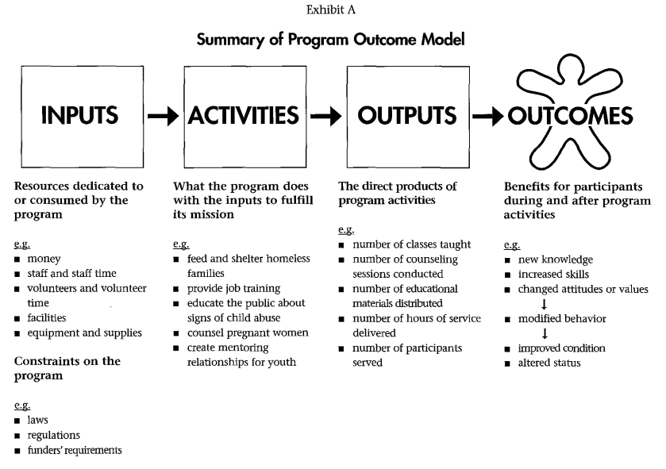
Performance Measures (Outcomes) Section

Slide 32
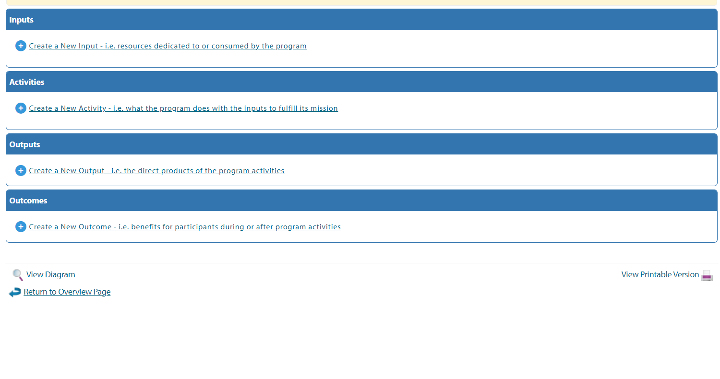
Performance Measures Section - How to Enter

Slide 33
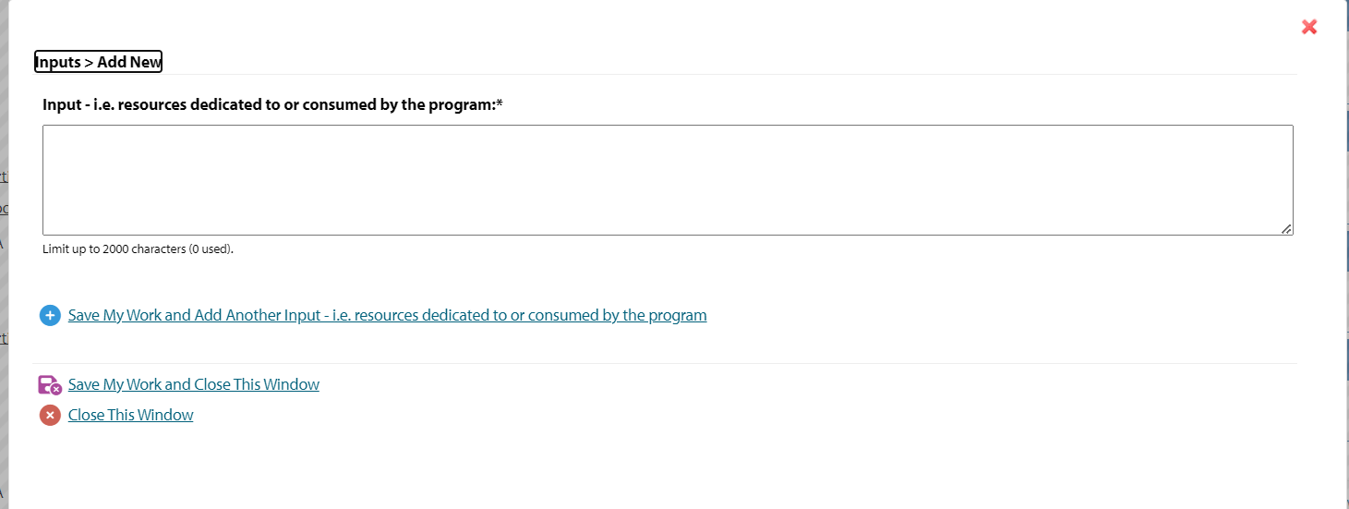
Performance Measures - Adding Inputs
Step 1 – enter input text
Step 2 – click "Save My Work" and Add Another Input OR
Close This Window as appropriate
Once done, your inputs will appear on the main screen

Slide 34
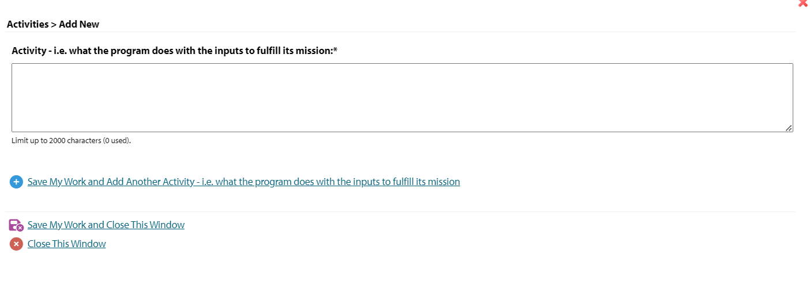
Performance Measures Section - Adding Activities
Step 1 – enter activities text
Step 2 – click "Save My Work" and Add Another Activity OR
Close This Window as appropriate
Once done, your activities will appear on the main screen

Slide 35
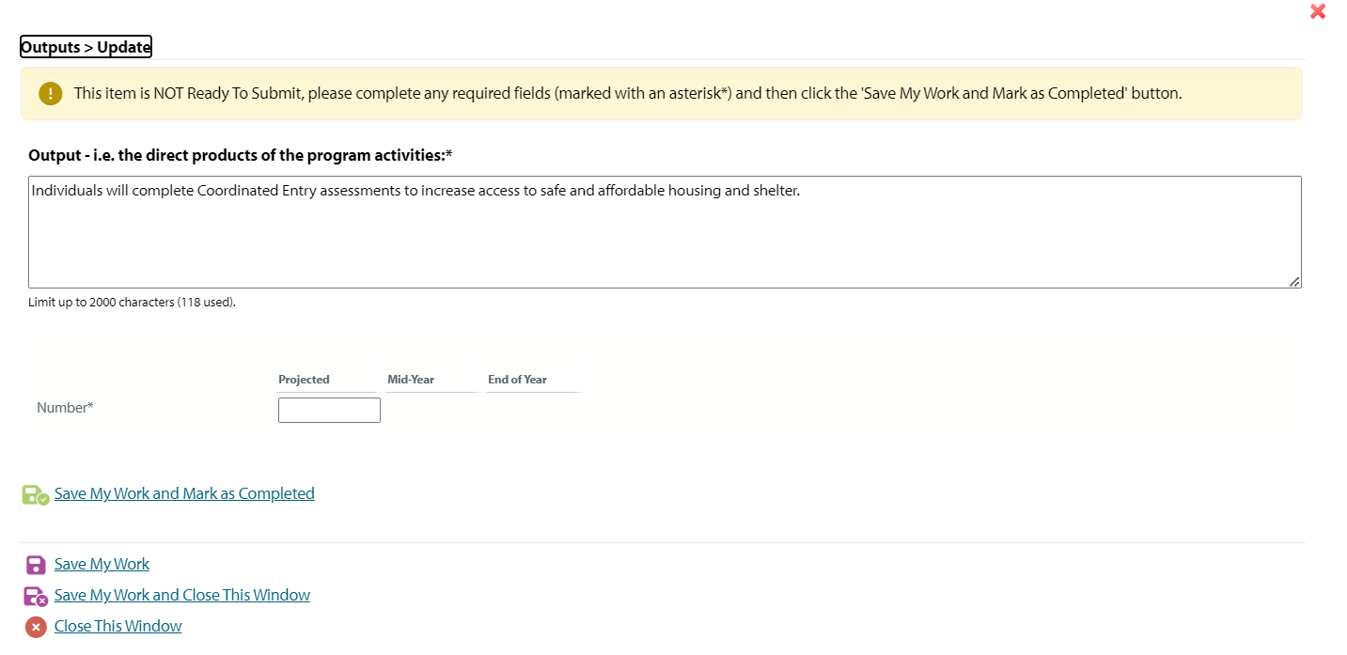
Performance Measures Section - Adding Outputs
Step 1 – enter output text
Step 2 – click "Save My Work and Continue" and you will be directed to the next screen
Step 3 – enter projected number of individuals/households/service units for the output
Step 4 – click "Save My Work and Mark as Completed"

Slide 36
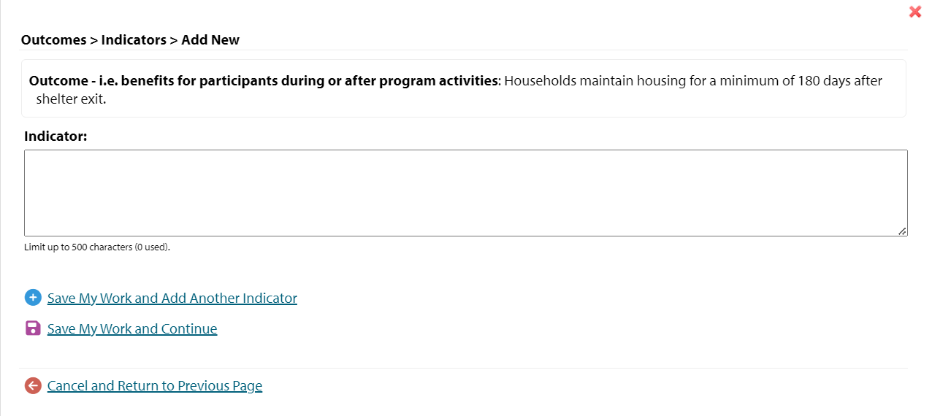
Performance Measures Section - Adding Outcomes
Step 1 – enter outcome text
Step 2 – click "Save My Work and Continue" and you will be directed to the next screen
Step 3 – enter the indicators (data) that will be used to measure the outcome
Step 4 – click "Save My Work" and Add Another Indicator OR
Continue as appropriate

Slide 37
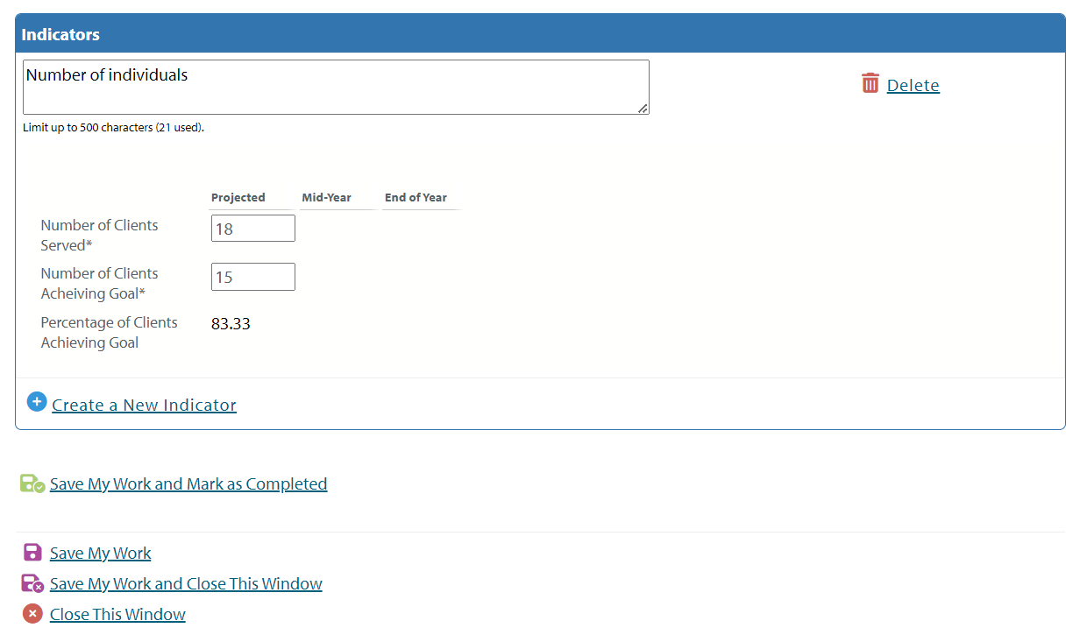
Performance Measures Section - Adding Outcomes
Step 5 – add number of clients projected to be served and number expected to achieve the goal stated in the outcome
Note – percentage of clients achieving goal will auto-calculate
Step 6 – click "Save My Work and Mark as Completed"

Slide 38
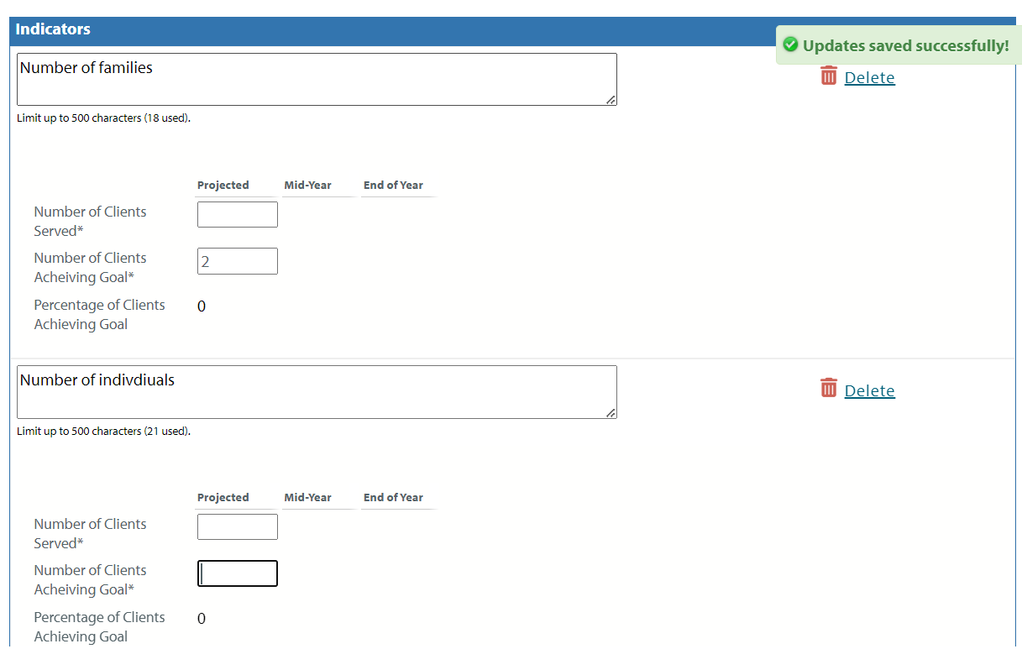
Performance Measures Section - Adding Outcomes
Note: for some outcomes, it makes sense to have more than 1 indicator. You can add up to 10 indicators per outcome statement

Slide 39
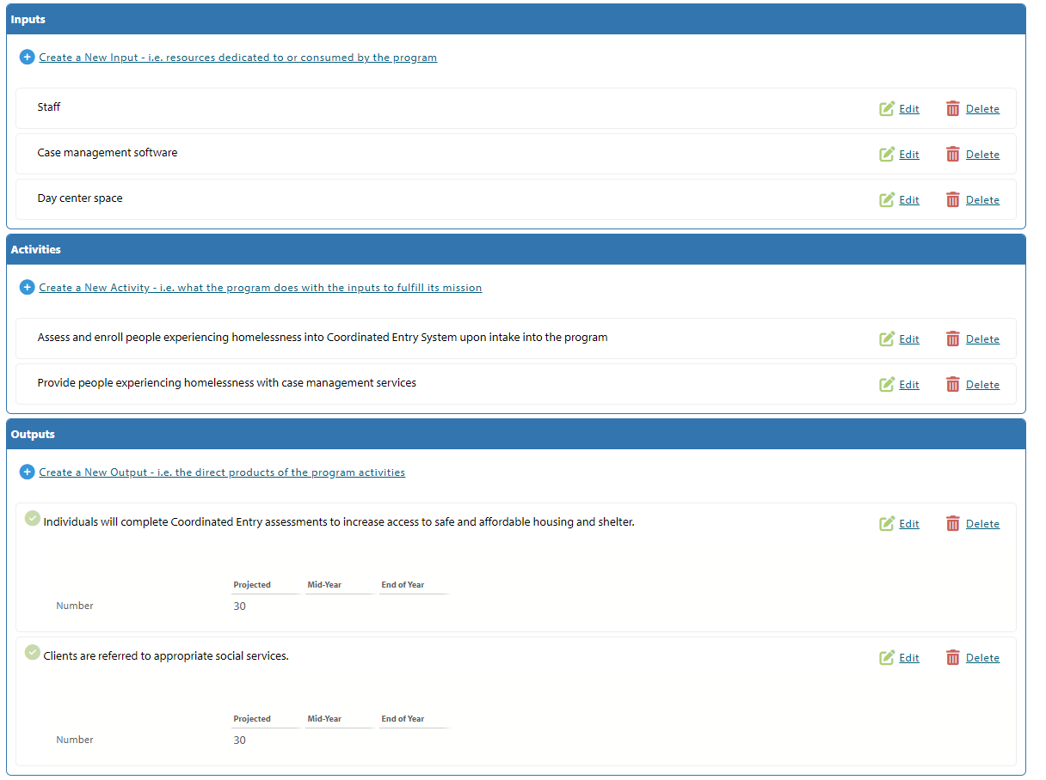
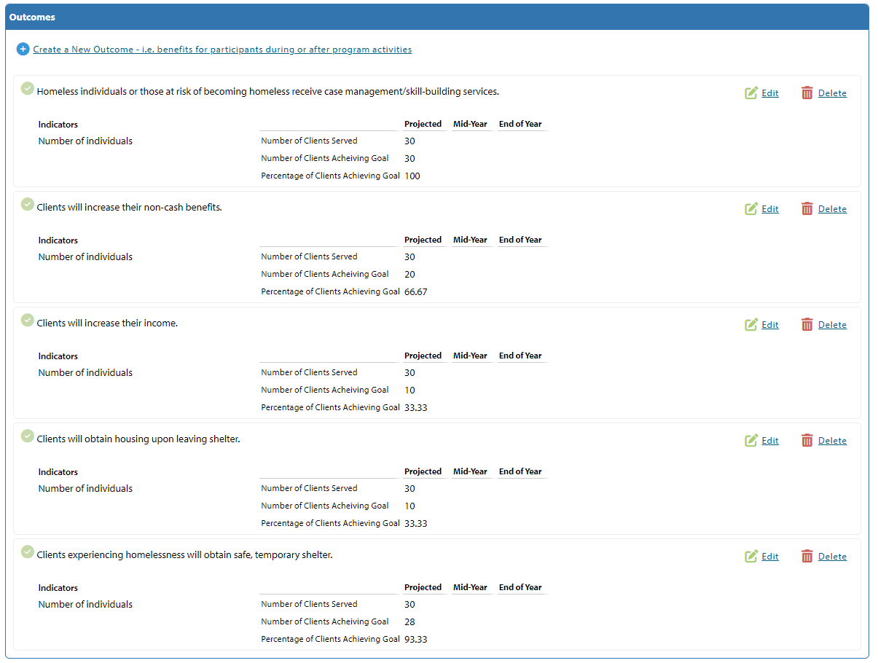
Performance Measures Section - Adding Outcomes
Once completed, you can review all entries on the home screen

Slide 40
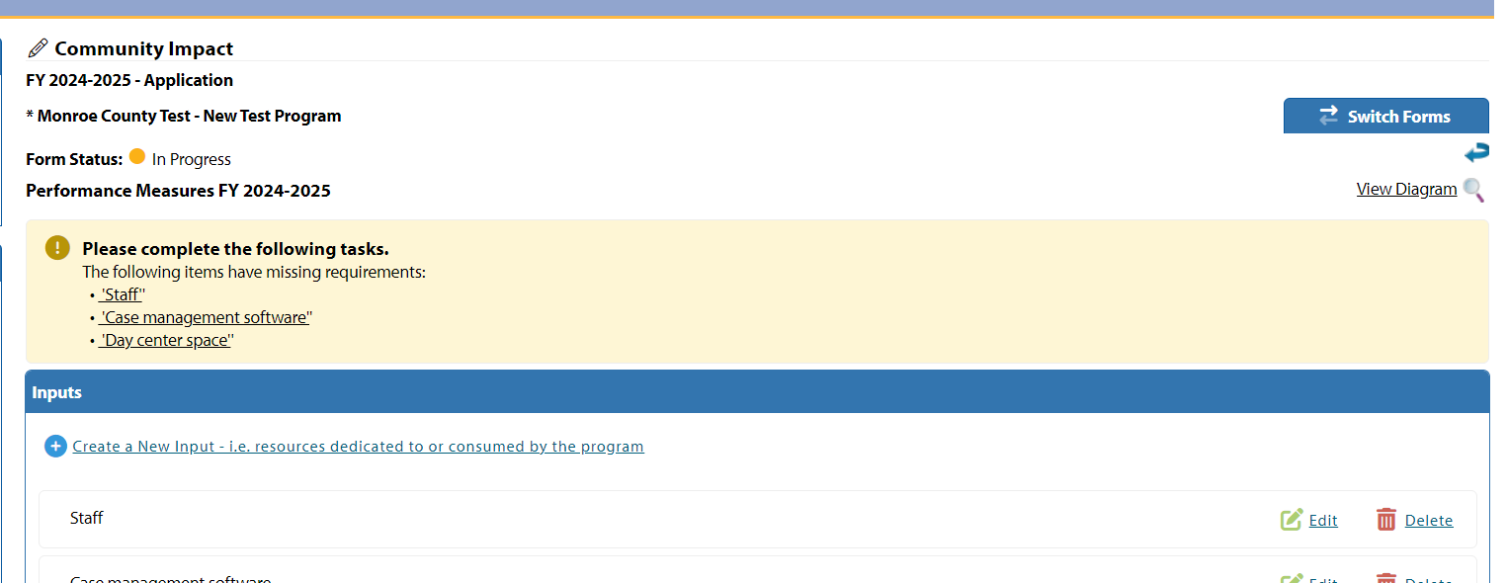
Performance Measures Section - Adding Outcomes
Click "View Diagram"

Slide 41
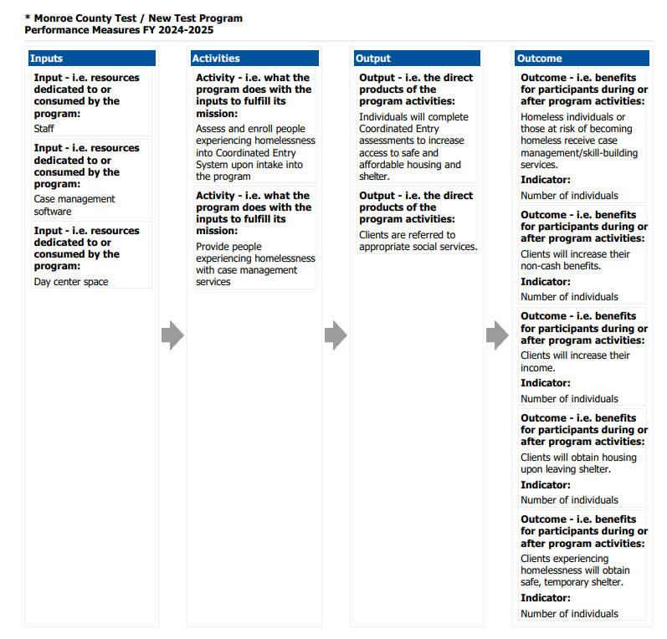
Performance Measures Section - Reviewing the Logic Model
Review all entries in the logic model

Slide 42
Performance Measures Section – Completing the Section
Congratulations! Your Performance Measures Section is now complete!
Close the logic model view, then click "Return to Overview Page" at the bottom of the screen

Slide 43
Other Reminders
Site Visits
This is your opportunity to "show off" your program
Consider what aspects of the agency/program will tell your story
Staff or volunteer meet and greet
Seeing facilities
Stories/client interaction (if appropriate and ALWAYS with consent)

Slide 44
Technical Assistance
PMUW staff are available for technical assistance when needed if you are having trouble with the website, questions about the application. Please do not wait until last minute on Friday, January 31st, to reach out for assistance.

Slide 45
Questions and Answers

Slide 46
Contacts
Maria Schramm (Primary Contact)
Maria@PoconoUnitedWay.org
570-517-5362
Sarah Jacobi
Sarah@PoconoUnitedWay.org
570-933-6059

